Slide 1

By: Git Dat Money (Group 1A) Paniz Herrera, Jahnavi Brahmbhatt, Brandon Meyer, Aidan Surowiec, Ignacio Velazquez
Capstone Project: Movie Analysis
March 2, 2023

Slide 2






Group 1A
Git Dat Money
Paniz Herrera
Aidan Surowiec
Risk & Advisory Analyst – Cyber Security
Cyber Strategy
Customer & Marketing Analyst – Advertising, Marketing & Commerce
Data Science, Analytics, Personalization
Jahnavi Brahmbhatt
Ignacio Velazquez
Risk & Advisory Analyst – Cyber Security
Cyber Application
Strategy & Analysis –
Artificial Intelligence
Brandon Meyer
Strategy & Analytics –
Artificial Intelligence Analyst

Slide 3
Agenda
1
Overview
Business understanding
2
Data Understanding
Data Analysis
3
Statistical Inference
4
Recommendations
Next Steps

Slide 4
Business Understanding
Evaluating the opportunity at hand for Computing Vision.
MARKET TREND
Company-original video content is on the rise, viewers are increasingly engaging more.
BUSINESS OPPORTUNITY
To position wisely, Computing Vision should create original content.
STRATEGICAL APPROACH
Analyze movies to gain insights into success factors in efforts to take a calculated approach towards allocating content creation budget.

Slide 5




Data Understanding
Overview of data sources, & information gained from each.
2 Data Sets
1 Data Set
1 Data Set
1 Data Set
Used for Movie Attributes | Used for Financial Analysis
Important Columns | Genre Director Writer
Limited number of box office observations. | Limited number of box office observations, primary purpose of data is not financial
Used for Movie Review / Rating Analysis | Used for Financial Analysis
Important Columns | Fresh
Utilized Fresh/Rotten score to standardize review analysis. | Both tables were joined to analyze reviews based on movie attributes Added column to return 1 if review is fresh (good), and 0 if rotten (bad)
Used for Financial Analysis | Used for Financial Analysis
Important Columns | Title Production Budget Domestic Gross Worldwide Gross
Domestic Gross & Worldwide Gross are a sum of only box office income. Added column: “Profit”, to find difference between Worldwide Gross & Production Budget. | Domestic Gross and Worldwide Gross are a sum of only box office income Added column, “Profit”, to find difference between Worldwide Gross and Product Budget
Used for Movie Characteristics & Ratings | Used for Financial Analysis
Important Columns | Title Vote Average Original Language
Used for Financial Analysis | Used for Financial Analysis
Important Columns | Title Studio Domestic Gross Foreign Gross
Domestic Gross & Foreign Gross are a sum of only box office income. | Domestic Gross and Foreign Gross are a sum of only box office income
Both tables were joined to analyze reviews based on movie attributes​.
Notes:
Aidan

Slide 6
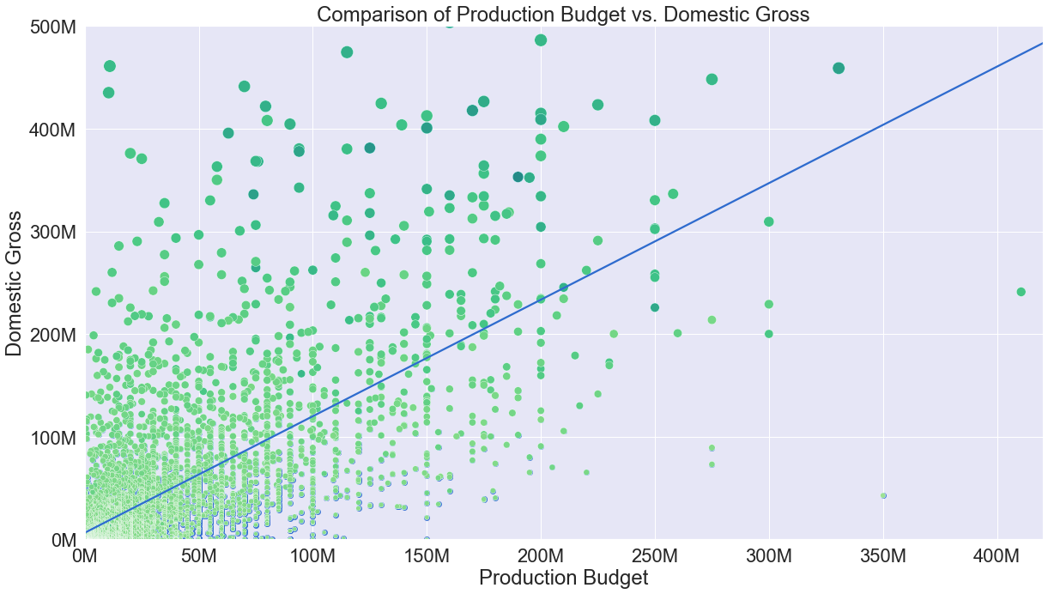
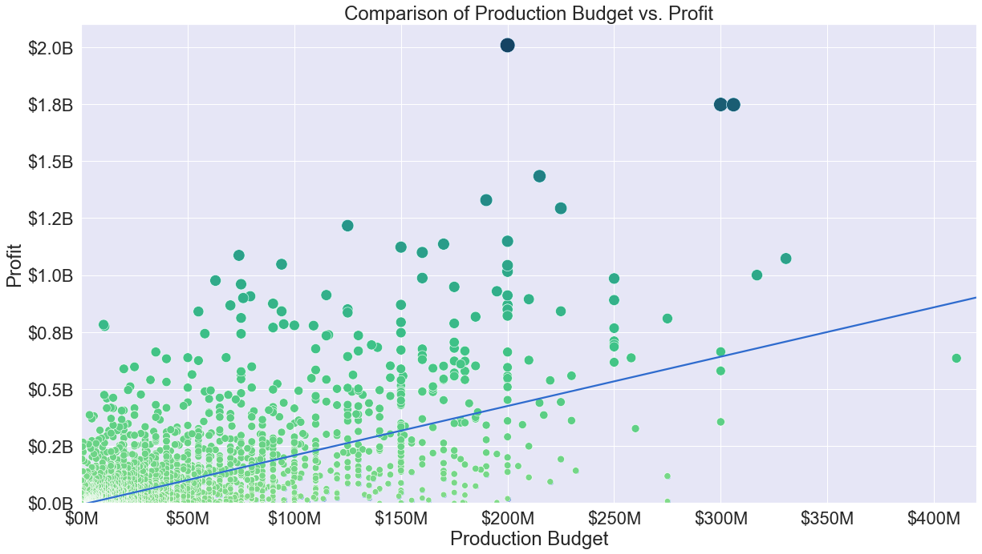
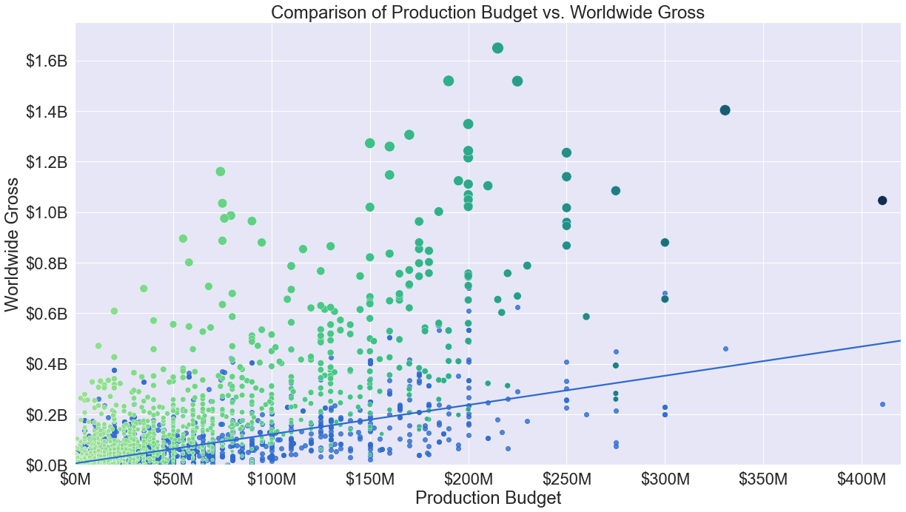
The Impact of Budget with Domestic & Worldwide Gross
The positive correlation of production budget compared to gross revenue streams.
Positive correlation on all aspects
Limitation: Accuracy of a true Production Budget – 10% buffer
Worldwide market does bring in more profit.

Slide 7
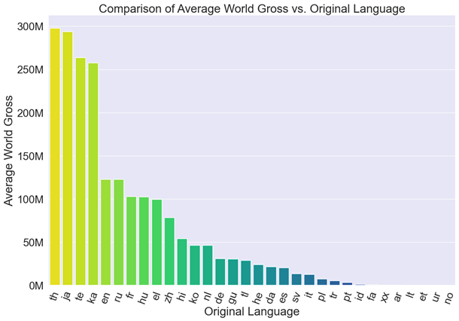
Worldwide Gross vs. Original Language
Analysis of Original Language
Our Analysis found that the Thai had the highest Worldwide gross while English had the 5th highest.
The Second highest language was Japanese.
The Top 5 languages are
Thai
Japanese
Telugu
Georgian
English
Notes:
Jahnavi Slide: Worldwide Gross v Original Language

Slide 8
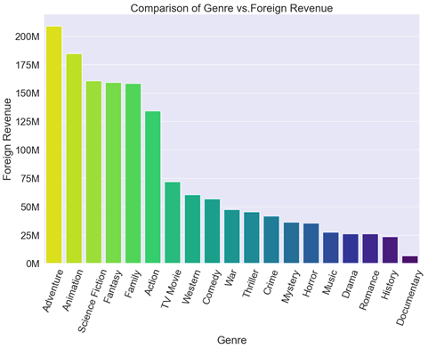
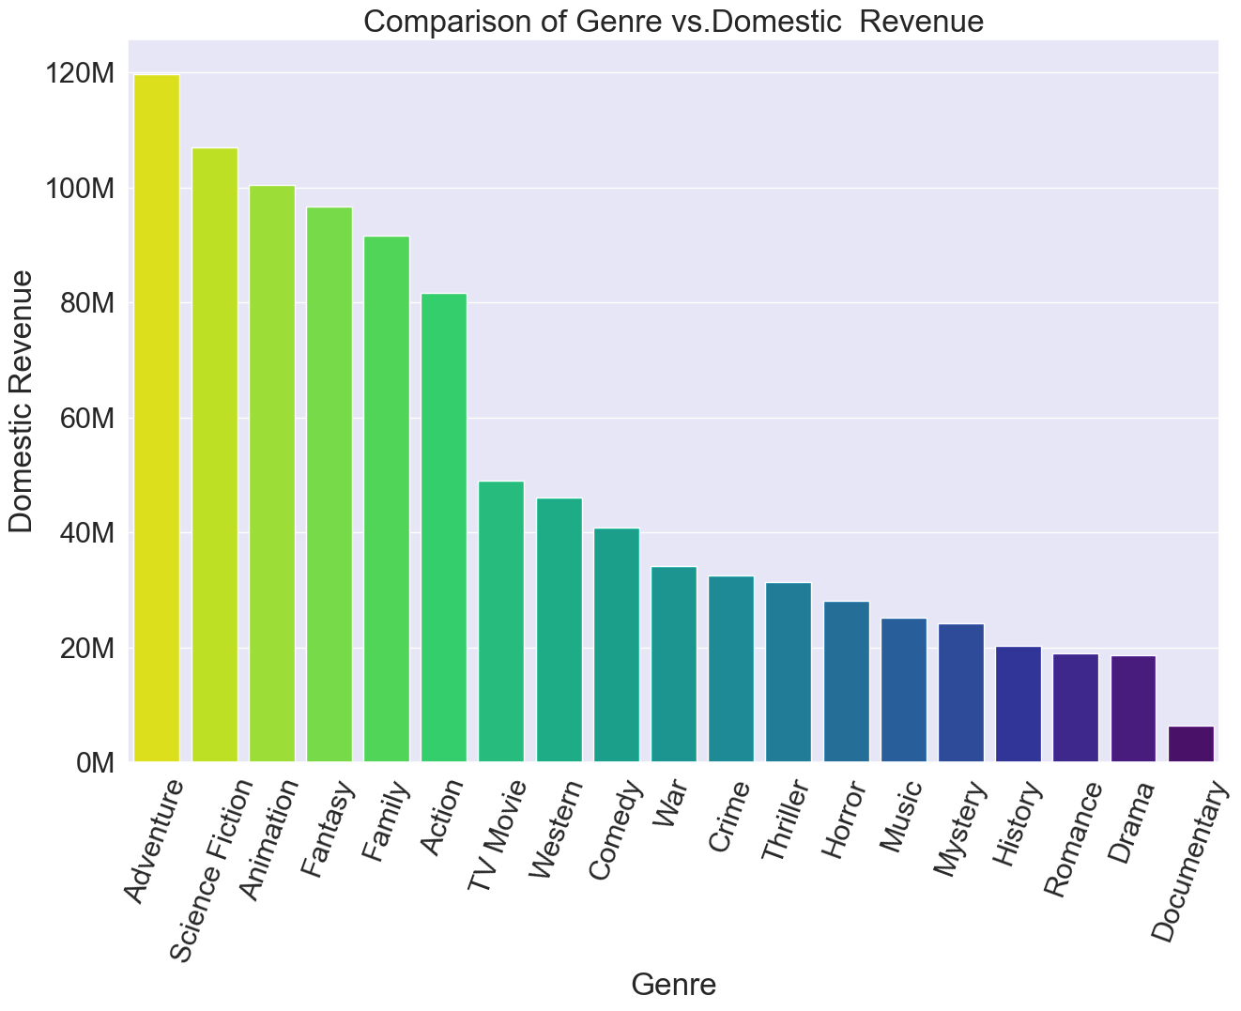
Genre vs. Foreign Revenue
Adventure Genre = Highest Revenue in both foreign revenue & domestic Revenue.
Documentary Genre = Lowest revenue in both foreign revenue & domestic Revenue.
Business recommendation: Invest in the top 3 genres for maximum returns (Adventure, Animation, Science Fiction)
Analysis of Genre and Foreign Revenue
Notes:
Jahnavi Slide: Genre V Revenue

Slide 9
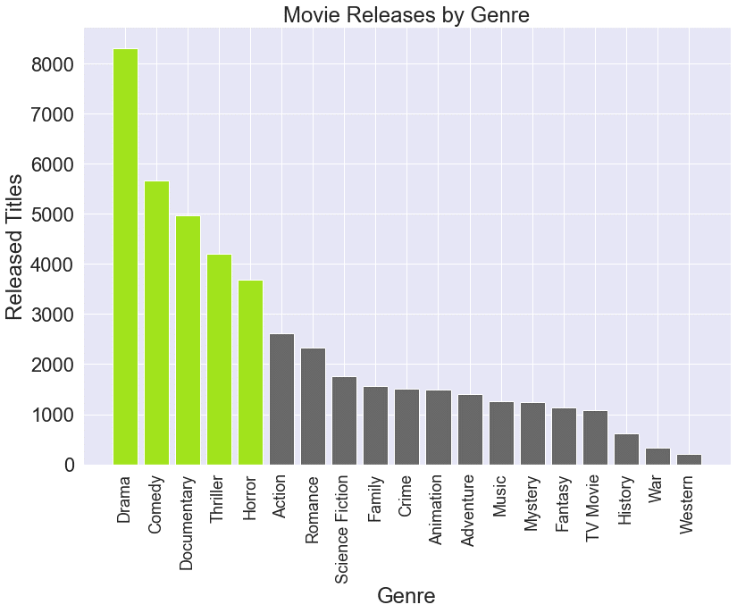
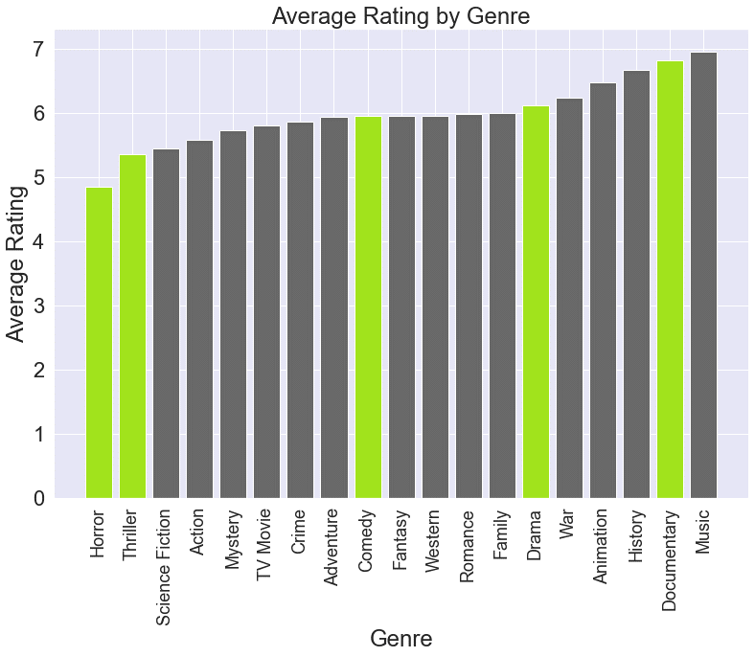
Genre vs. Popularity Analysis
Top 5 most produced genres: Drama, Comedy, Documentary, Horror, Thriller
Genre recommendation: Adventure has great ratings & is not a saturated market
Extracted from Box Office and Rotten Tomatoes.*

Slide 10
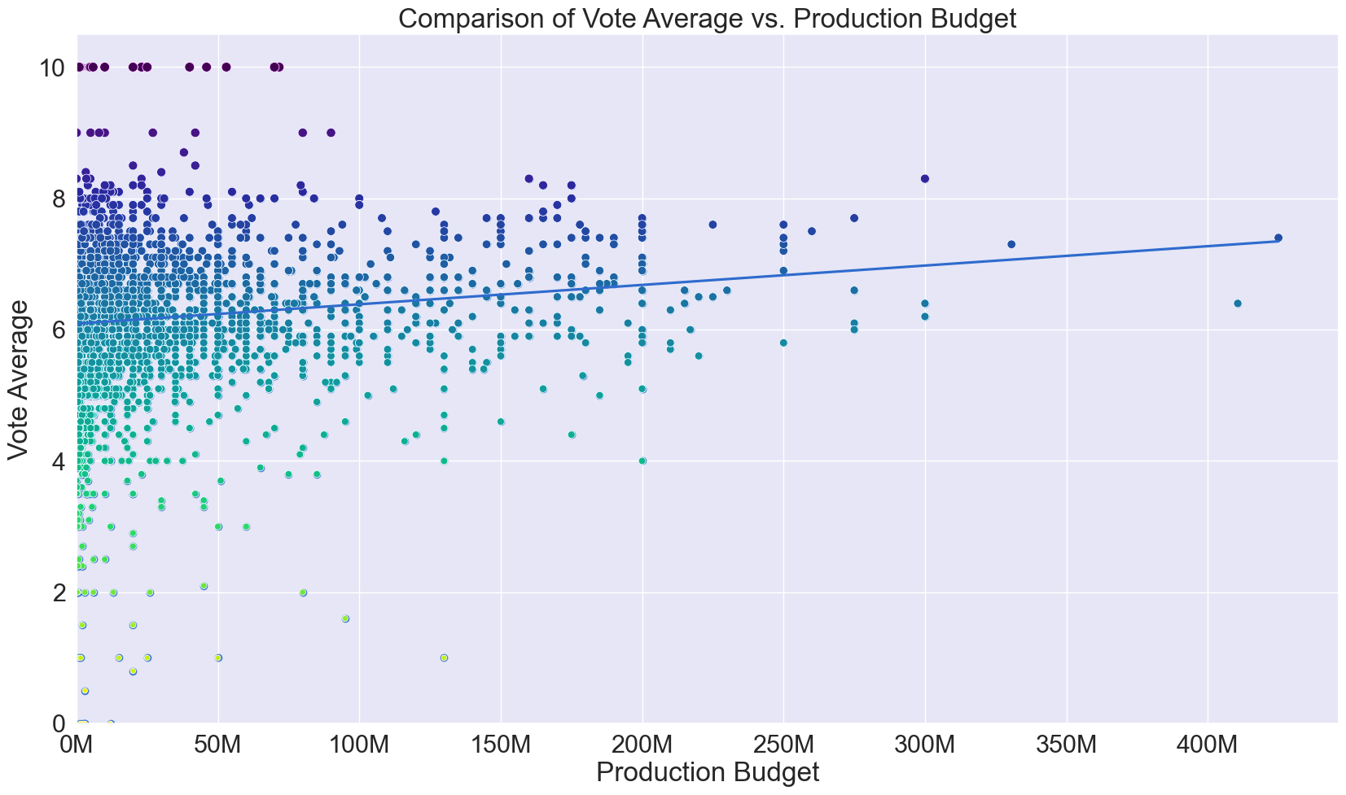
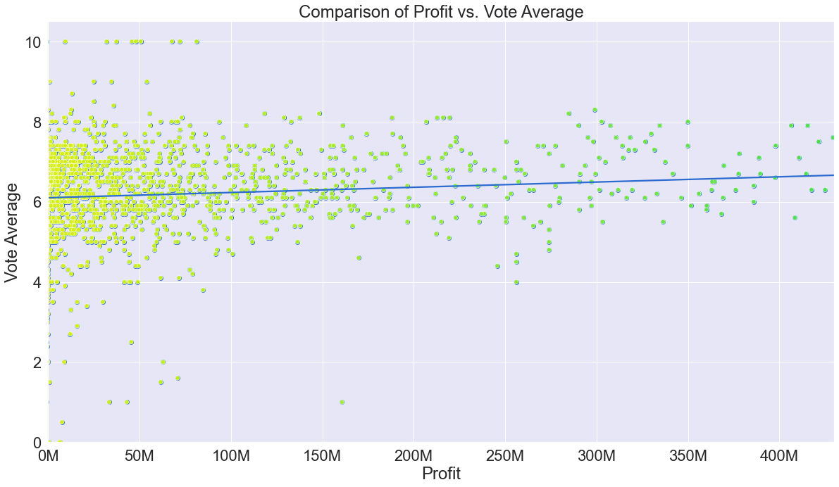
Vote Average Analysis
Analysis of relationship between financial outcomes of a movie & ratings.
Visible positive relationship between vote average & production budget.
- Higher production budgets lead to movies with higher ratings.
Slight positive relationship between profit* & vote average (movie rating).
- Movies with high ratings bring in more profit
- Movies on the higher end of the profit scale generally do not have a vote average less than 6
Notes:
Jahnavi Slide: Worldwide Gross v Original Language

Slide 11
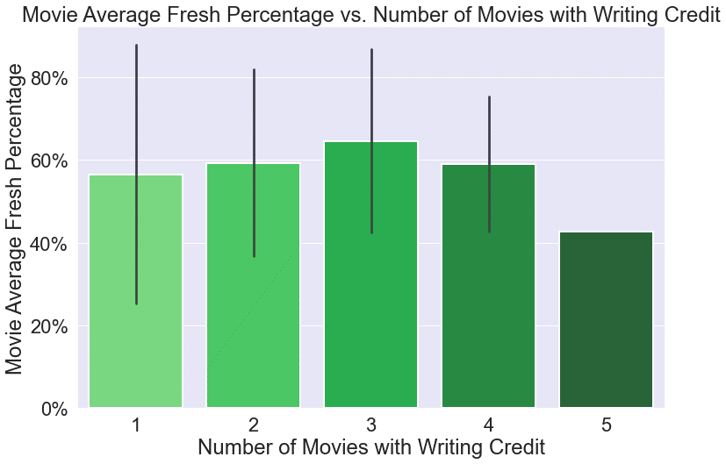
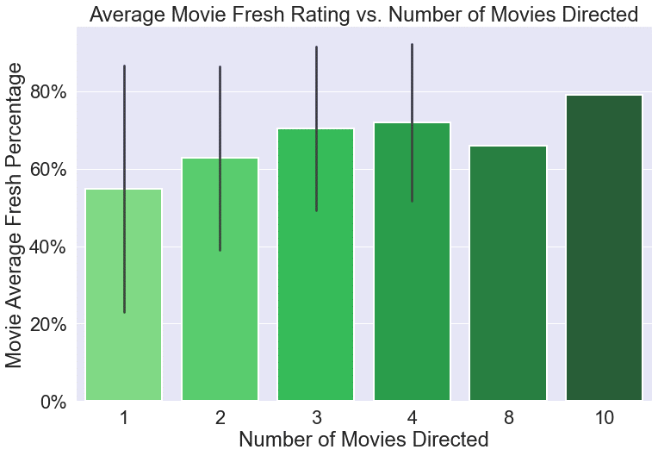
Director & Writer Analysis
Writer Comparison:
Analysis of relationship between ratings & individual directors /writers.
Appears to be a positive relationship between average movie Fresh (good) percentage & number of films a director has made.
1st time directors have the largest variance in average Fresh percentage.
The number of movies a writer has worked on does not seem to have a relationship with average movie Fresh rating.
Recommendation: More experienced directors lead to higher rated movies.
Director Comparison:
Notes:
Jahnavi Slide: Worldwide Gross v Original Language

Slide 12
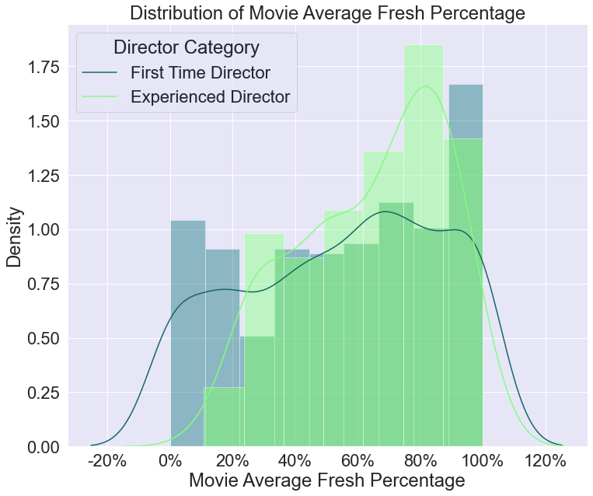
Hypothesis Testing
Does director experience lead to a higher average percentage of Fresh ratings on Rotten Tomatoes?
Null Hypothesis: Distributions of movie Fresh percentage for first time directors are statistically similar to experienced directors.
Alternative Hypothesis: Distributions of movie average Fresh percentage for experienced directors are higher than for first time directors.
Testing Conclusion:
Mann-Whitney U test: Conclude that the movie average fresh percentage is significantly greater for movies that were directed by a director who has worked on 2 or more movies.
Linear Regression Results:
Model 1: As a director gains one movie in experience, the fresh percentage is expected to increase by 5%
Model 2: For every fresh percentage point gained, we can expect to see box office revenue increase by $16.7K
Key Variable: Fresh Percentage
- Sum of Fresh (good) reviews/total number of reviews.
Key Variable: Movie Average Fresh Percentage
- Average of fresh percentage = All percentages/number of movies directed.
Rotten Tomatoes Reviews*
Notes:
Aidan

Slide 13

Recommendations for Computing Vision
PRODUCE AN ADVENTURE MOVIE
To maximize profitability the company should implement the following recommendations.
GO GLOBAL
Our analysis indicates it is the most profitable genre and is averagely reviewed.
Not only does this impact profit but also essential to language variety worldwide.
FOCUS ON THAI AND JAPANESE LOCALIZATIONS
HIRE EXPERIENCED DIRECTORS
Directors with more than one movie under their belt tend to have better rated movies.
For an international release, the Asian market should be prioritized.
Notes:
Tags: DNA, underline, text

Slide 14






Next Steps
Further Analysis
AI APPLICATION
Prediction model for movie ratings & financial outcomes.
IN-DEPTH TIMELINE ANAYSIS
Trends over time & the impact → revenue.
DEMOGRAPHIC ANALYSIS
Demographic analysis of reviewers & overall popularity demographic based on genres.
Notes:
Tags: technology, callout, icons

Slide 15
Q&A
Thank you for your time & we hope you gained valuable insight from the presentation.
Contact Information
Jahnavi Brahmbhatt
Email: jabrahmbhatt@deloitte.com
LinkedIn: /jahnavi-brahmbhatt
Paniz Herrera
Email: panherrera@deloitte.com
LinkedIn: /PanizHerrera
Ignacio Ferrera
Email: jvelazquezferrera@deloitte.com
LinkedIn: /IgnacioVelazquezFerrera
Brandon Cancino
Email: bcancinomeyer@deloitte.com
LinkedIn: /brandon-u-meyer
Aidan Surowiec
Email: asurowiec@deloitte.com
LinkedIn: /aidan-surowiec

Slide 16
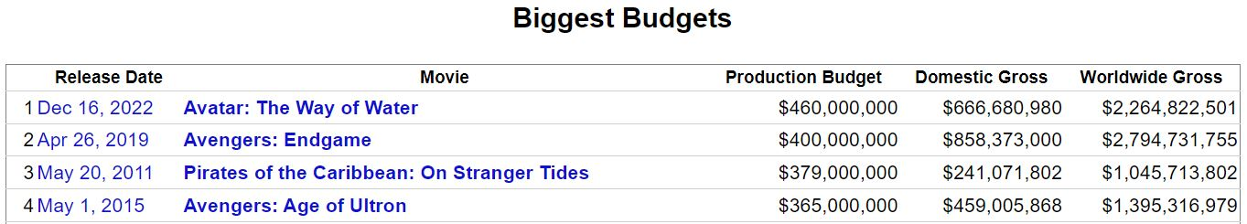
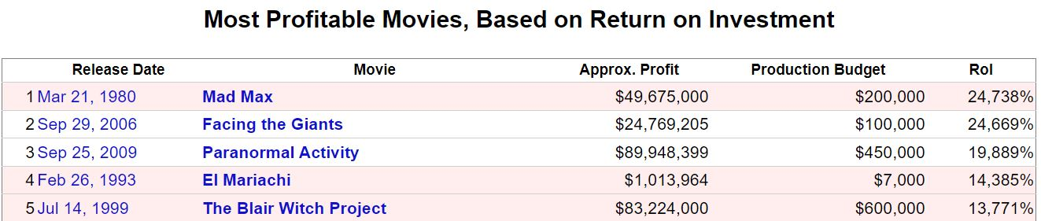
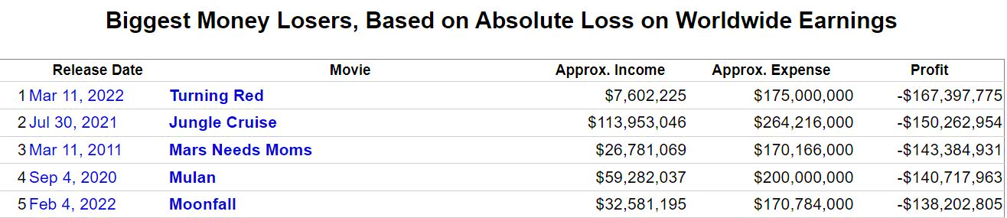
Appendix
Further analysis on Budget / Worldwide Earnings / ROI.

